Slide 1
E COMMERCE WEBSITE FOR VISUALLY IMPAIRED
HIBA (MES22MCA-2026)

Slide 2
GUIDED BY:
VASUDEVAN T
ASSISTANT PROFESSOR
MASTER OF COMPUTER APPLICATIONS
MES COLLEGE OF ENGINEERING, KUTTIPPURAM

Slide 3
CONTENTS
INTRODUCTION
PROBLEM STATEMENT
TECHNOLOGY STACK
MODULES
FLOW CHART
DATA FLOW DIAGRAM
PRODUCT BACKLOG
USER STORY
PROJECT PLAN
SPRINT PLAN

Slide 4
INTRODUCTION
E-commerce is a critical part of the modern economy, but it can be difficult for people with visual impairments to use e-commerce websites. An e-commerce website for visually impaired users should be designed. The website would have text-to-speech capabilities so that visually impaired users could hear the text on the page. This would allow them to navigate the website and read the product descriptions without having to see them. The development of an e-commerce website for visually impaired users would be an important step towards making e-commerce more accessible to everyone. By making e-commerce more accessible, we can help to ensure that people with visual impairments have the same opportunities to participate in the digital economy.

Slide 5
PROBLEM STATEMENT
An ecommerce website is developed to assist blind people that automatically recognize by speech. This system processes the voice output, and asks for the input by pressing the button of their desire choices. Which will help them to buy their desired products online. All kind of instructions will be provided to them in the form of audio, they need to hear and follow the instructions.

Slide 6
TECHNOLOGY STACK
Frontend
Javascript
HTML/CSS
Backend
FLASK (Python)
MySQL DataBase
Speech Recognition & Text-to-Speech
Web Speech API (SpeechSynthesis and SpeechRecognition())

Slide 7
MODULES
ADMIN
LOGIN
VIEW PRODUCTS
ADD PRODUCT
EDIT PRODUCT
DELETE PRODUCT
VIEW CUSTOMER LIST
VIEW ORDERS
USER
LOGIN
REGISTER
VIEW PRODUCTS
ADD PRODUCT TO CART
VIEW CART
ORDER PRODUCTS
VIEW ORDERS

Slide 8
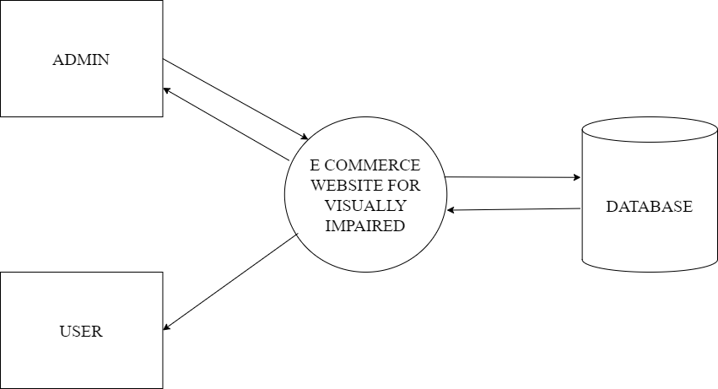
DATA FLOW DIAGRAM

Slide 9
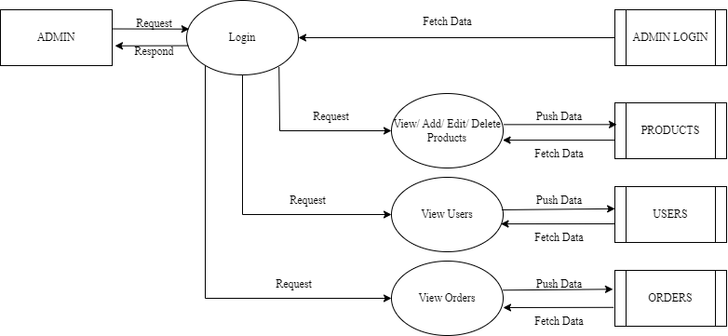
DATA FLOW DIAGRAM
Level 1 - admin

Slide 10
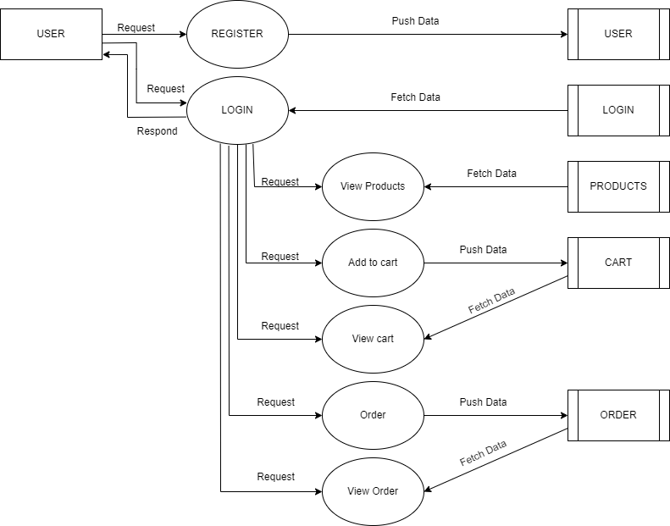
DATA FLOW DIAGRAM
Level 1 - user

Slide 11
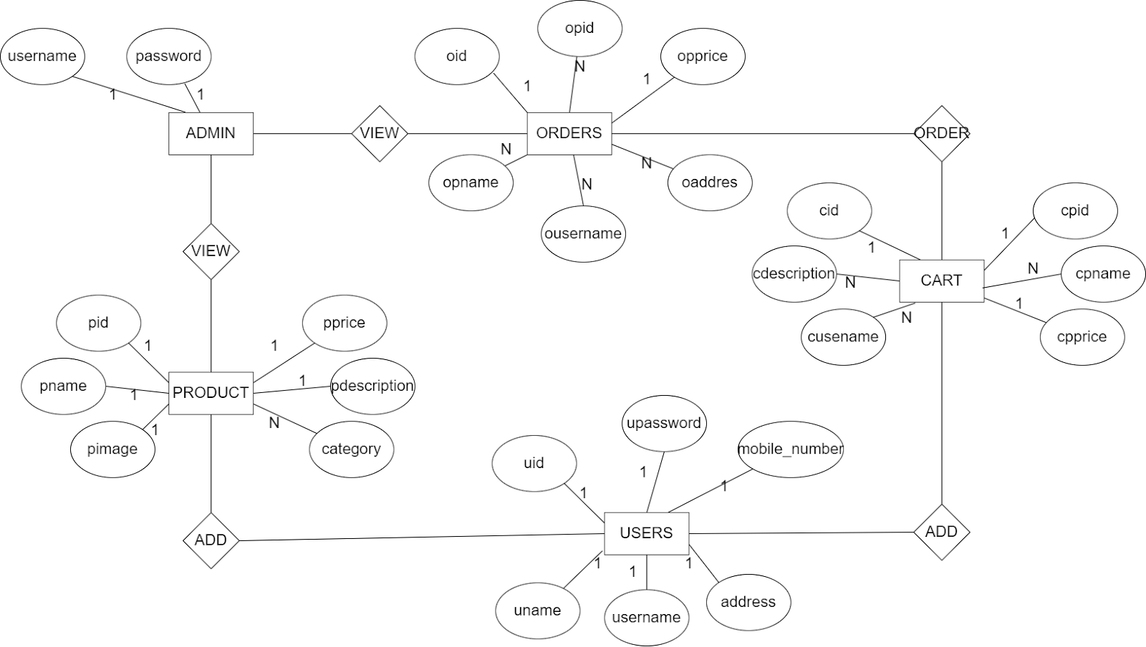
E R DIAGRAM

Slide 12
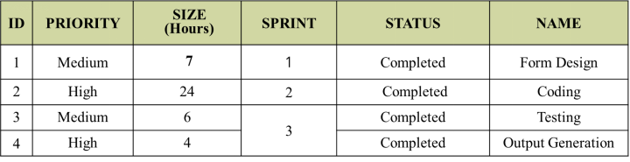
PRODUCT BACKLOG

Slide 13
USER STORY
USER STORY ID | As a <type of user> | I want to | So that I can
1 | Admin | Login | Login successfully with correct username and password
2 | Admin | View products | View the list of all products
3 | Admin | Add products | Add new products for the user
4 | Admin | Edit products | Edit the details of the already existing products
5 | Admin | Delete products | Delete the products
6 | Admin | Customer list | View the list of the customers
7 | Admin | View Orders | View the orders made by the customer

Slide 14
USER STORY
USER STORY ID | As a <type of user> | I want to | So that I can
8 | User | Login | Login successfully with correct username and password
9 | User | Register | Register if the user hasn’t already registered
10 | User | View products | View the products
11 | User | Add to cart | Add the products to the cart
12 | User | Order products | Order the products from the cart
13 | User | View ordered products | Know the products the has ordered

Slide 15
PROJECT PLAN
ID | TASK NAME | START DATE | END DATE | PROJECT HOURS | STATUS
1 | Sprint 1 | 15/09/2023 | 12/10/2023 | 10 | Completed
2 | Sprint 2 | 13/10/2023 | 03/11/2023 | 25 | Completed
3 | Sprint 3 | 08/11/2023 | 30/11/2023 | 15 | Completed

Slide 16
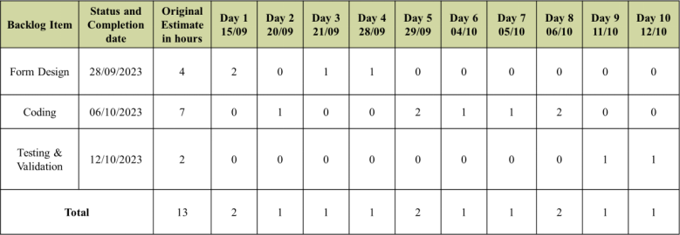
SPRINT PLAN

Slide 17
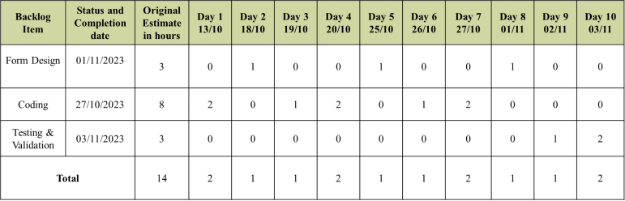
SPRINT PLAN

Slide 18
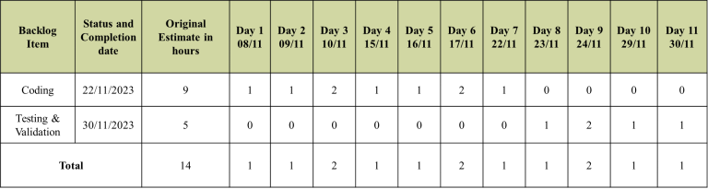
SPRINT PLAN

Slide 19
THANK YOU

